Slide 1
Mapping Regional Capacities for
Evidence-based Policy Making in Education in South Eastern Europe
An exploratory analysis of Albania, Bosnia and Herzegovina, Croatia, Macedonia, Moldova, Montenegro and Serbia
PRELIMINARY FINDINGS
Belgrade, December 7 2011
Žana Bogunović & Jelena Branković

Slide 2
Aims
Map capacities for evidence-based policy making (EBPM) in education – actors, evidence and interaction in South Easter Europe (SEE)
Identify major challenges and ways to address them
Identify EU funding opportunities for enhancing the state of affairs through regional cooperation
2

Slide 3
Methodology
Three areas of enquiry: decision makers (DM), evidence providers (EP) and research and evidence
Data-collection method: structured interview (DM+EP), questionnaire (EP), documentary analysis
Countries: Albania, Bosnia and Herzegovina, Croatia, Macedonia, Moldova, Montenegro and Serbia
Research period: Oct. & Nov. 2011 (8.5 weeks)
3

Slide 4
Data collection stats
 | Interviews (individual & group) |  | Interviewees
 | Decision makers | Evidence providers | Decision makers | Evidence providers
Albania | 2 | 3 | 2 | 5
B&H | 1 | 2 | 2 | 3
Croatia | 3 | 4 | 3 | 4
Macedonia | 1 | 1 | 5 | 1
Moldova | 1 | 2 | 1 | 2
Montenegro | 3 | 1 | 4 | 1
Serbia | 2 | 3 | 2 | 6
Total | 13 | 16 | 19 | 22
 | 29 |  | 41
4

Slide 5
Data collection stats (cont.)
Questionnaire (Evidence providers)
 | Sent | Filled
Albania | 5 | 2
B&H | 11 | 3
Croatia | 7 | 3
Macedonia | 4 | 0
Moldova | 9 | 1
Montenegro | 3 | 2
Serbia | 7 | 4
Total | 46 | 15
5

Slide 6
Selected preliminary findings
6

Slide 7
(1) Actors, evidence & interaction
7

Slide 8
Decision makers
Ministries responsible for education/Agencies or other units under government which act as policy makers;
Act within similar governance arrangements; exception: Bosnia and Herzegovina;
Sharp division of the education policy making between pre-university education and higher education in all countries;
Very good understanding of the importance of EBPM, diversity in the actual understanding of what EBPM is and how it takes place;
8

Slide 9
Evidence providers
Four types identified*:
Units within the government
Independent research institutes
Research units as parts of universities
Non-governmental organizations
Their influence, thematic focus, source of funding, capacity, the relationship with DM vary across the region.
*not including international institutions/organizations.
9

Slide 10
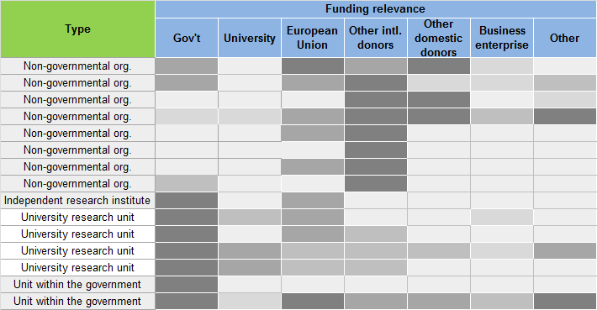
Funding source relevance for EP (questionnaire)
10

Slide 11
11

Slide 12
Evidence and research (last 5 yrs)
12

Slide 13
Evidence and research (last 5 years)
13

Slide 14
14

Slide 15
International institutions/organizations as evidence providers
We looked at: EU, OECD, OSF, UNESCO, UNICEF, World Bank
Similar influence and thematic focus across the region;
Dominant thematic scope:
Teaching & learning
Equity & social dimension
Policy & governance
Interview data in some of the countries indicate that DM are more responsive to the evidence coming from these institutions than to the local ones.
15

Slide 16
16

Slide 17
Relationship between DM & EP (interview)
Positive attributes prevail, but there are interviewees who pointed out some shortcomings.
Actor | Dominating negative aspects of the relationship
Decision makers | Relationship with evidence providers is not systematic; Relationship is individual or informal; Cooperation at the institutional level is too formal.
Evidence providers | Relationship with the Ministry is based on personal relationships; No regular cooperation, rather ad hoc;
17

Slide 18
Policy makers – researchers interaction
Capacity in terms of evidence provision exists, which is accompanied by the providers’ clear willingness to participate more actively in the policy making;
Albeit EP perceive government as the prime user of their work, they see their research as not sufficiently absorbed by the policy process (variations);
DM tend to claim that data and research are not systematized, sometimes methodologically incompatible or unreliable, scattered, not communicated in a policy-friendly manner, etc.
18

Slide 19
Policy makers – researchers interaction (cont.)
With regards to the decision makers, the will to foster cooperation with researchers is also very present, yet in most cases there is no clear vision of how this relationship should look like;
The existing relationship and interaction is not based on formal institutional links, but rather on ad hoc or random communication and cooperation, and sometimes of informal nature.
The interaction is in principle reactive or problem driven, rather than proactive or strategic.
19

Slide 20
(2) Challenges
20

Slide 21
21

Slide 22
22

Slide 23
Challenges to EBPM
EBPM is not institutionalized as an approach to policy making in education in the seven countries: decisions and actions still depend on individuals; high exposure to international actors’ policies and supra-national policy processes; old ways of policy making prevail.
Poor organizational linkages (1) between governmental institutions and (2) between education policy makers and research organizations (esp. civil sector); lack of trust.
Poor or no evidence collection, systematization and analysis by policy makers; little effort from research institutions to communicate their work in a ‘policy-friendly’ manner.
23

Slide 24
Challenges to EBPM (cont.)
Poor data collection by official statistics offices and ministries; most data often not publicly available;
Lack of competence and/or capacities for EBPM in policy makers
Little transparency of the policy making process
Poor organizational memory in policy makers;
Political instability;
Policy mimicking rather than policy learning;
Robustness of the policy process;
24

Slide 25
(4) Recommendations
25

Slide 26
Recommendations for policy makers
Establish a communication platform for policy makers and researcher/experts in the field of education at national levels and regional level;
Secure transparency in policy and decision making by opening up the process;
Stimulate involvement of researchers and experts all along the policy cycle and encourage feedback;
Strengthen links between governmental units;
Create a publicly available knowledge base of existing research in education for the entire region;
26

Slide 27
Recommendations policy makers(cont.)
Introduce incentives for, or urge research institutions/organizations to produce policy relevant research and/or to communicate it in a manner readable to policy makers;
Enhance research and data reliability;
Build institutional capacities within the government for EBPM through regional cooperation;
Encourage exchange of good practices in EBPM through joint regional ventures;
27

Slide 28
Two prerequisites for creating education policies based on evidence:
Capacity
Will
28

Slide 29
(4) Funding opportunities
for capacity bulding
29

Slide 30
What do we need funding for?
Regional cooperation, peer learning, exchange of practices;
Cooperation with other European countries in the domain of education policy making and the use of evidence;
Building local and regional capacities for enhancing the quality of policy making, implementation and evaluation;
Strengthening institutional capacities and linkages within each country of the region;
30

Slide 31
EU funding opportunities
 | ENPI | TAIEX | TEMPUS | IPA | LLP
Albania | o | x | x | x2 | xo
Bosnia and Herzegovina | o | x | x | x2 | xo
Croatia | o | x | ox | x5 | x
Macedonia | o | x | ox | x5 | xo
Moldova | x | x | x | o | o
Montenegro | o | x | x | x5 | xo
Serbia | o | x | x | x2 | xo
31

Slide 32
thank you
32

